Slide 1
PATIENT ENVIRONMENT MANAGEMENT SYSTEM USING IOT AND MACHINE LEARNING
19BAI1069 – Araadhye Jain
19BCE1657 – Tatvavid Tripathi
19BCE1352 – Anshuman Singh
19BAI1007 – Piyush Parashrampuria

Slide 2
Abstract
IoT has seen significant growth in the field of health-sector. With the advent of new technology both in the field of IoT simulation and Application deployment, we can now create a system capable of assisting a regular patient or patient left in self-care in their daily day-to-day medication routines and providing them ways to interact with the room environment around them.
Such a system will help those patients who either forget their medication doses or are handicapped in controlling common room appliances such as TV, AC, room light, etc, also providing the means to track their body-state such as oxygen level, pulse rate, body temperature, etc.
Apart from that, the system will be capable of identifying the critical conditions and providing an emergency solution for the same. The proposed system will be capable of providing the user/patient an Application based control. The IoT system will be developed as hardware, with data analysis done on cloud and cross-platform applications.

Slide 3
Literature Survey
Some related works have already been done in terms of creating an environmental management system. The works outlined are as follows.
Ibrar Yaqook et al. developed a state of art based smart environment using IoT which aims to support and enhance the abilities of its dwellers in executing their tasks, such as navigating through unfamiliar space and moving heavy objects for the elderly
y R. Kumar et al. proposed a framework for An IoT based patient monitoring system using Raspberry Pi in which the proposed system, they are using the sensors like the temperature sensor and the heartbeat sensor to measure the temperature and the heartbeat of the patient.
Pradhan B. et al. proposed healthcare-based devices which aid to integrate the advantages of IoT technology and cloud computing with the field of medicine. It also lays out the protocols for the transmission of the patient's data from numerous sensors and medical devices to a given healthcare network.

Slide 4
Proposed System
A quick glance
The proposed system will contain three interconnected modules. These modules are as follows
Medicine Scheduler: A sub-module which enables the user to specify medicine, description and course-schedule. This module support both automatic and manual mode at hardware level for setting the schedule.
Environment control: This module will enable user to have access to basic smart devices around their environment. This is useful especially for those users who are bed-patients and need support for basic utilities around them.
Self Health Monitor : This module will give user access to information and suggestion about their current health.

Slide 5
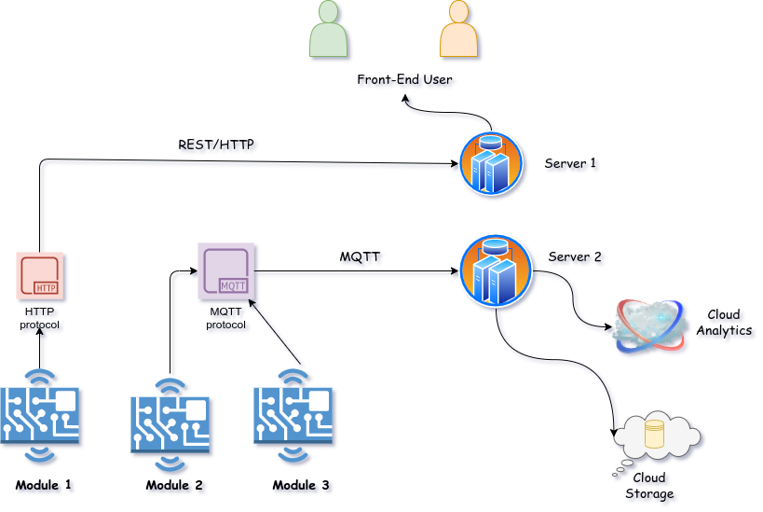
Architectural Design / Flow diagram

Slide 6
Outline of working principle
The medicine Scheduler allows user to specify schedule for their daily medication and ensure user does not miss the course of medication.
The system will allow user to put their medicines in separate container each with different types.
With the help of application user can specify schedule and when it’s right exact time for medicine the scheduler will ring alarm and the container with the specified medicine will rotate along with indication for the medicine.
The environment control module will help regulate the environment both automatically and manually. This module in sync with body sensors will manage the environment around the user.
For example, depending on the user body temperature the system can regulate the humidity and temperature by having access to the smart ac in control. The light automatically turns off when the user sleeps by tracking the pulse and ecg from sensors.

Slide 7
Implementation Modules
The Implementation of the system will be divided into 4 parts namely, Application deployed, server-integration, hardware-implementation and cloud-analytics.
Application : The application will be cross-platform based which will help us to target all kinds of device users (IoS, Android, Desktop, Web).
Server : The server will be made to server as the medium between hardware, cloud and application. This includes both real-time server and REST based server.
Cloud: The analytics and database integration for the system will both cloud-based
Hardware: The physical implementation of the system will be hardware based.

Slide 8
Implementation Tools
For each module we will be using following tools as pre-draft. Note that we may incorporate more tools based on the future need.
Application: Primary development using Flutter
Server: NodeJS express for REST based server, Java Spring Boot, Hibernate for Real-time server
Cloud and Database: Google Cloud for MYSQL database and analytics (comes with 90 days free access)
Hardware (pre-draft version)
Node-Mcu (Microcontroller with inbuilt-wifi)
LCD display
Micro Servo motors
Sensors:
DHT11 Temp, humidity, pressure
BMP180 Pressure
MAX 30100 pulse and oximiter
MAX 30200 ecg sensor
DS18B20 Temperature probe

